Slide 1
Symbolic Verification of Remote Client Behavior in Distributed Systems
Robby Cochran
University of North Carolina at Chapel Hill

Slide 2
Committee
Cristian Cadar (Imperial College London)
Somesh Jha (University of Wisconsin - Madison)
Fabian Monrose (University of North Carolina at Chapel Hill)
Dinesh Manocha (University of North Carolina at Chapel Hill)
Mike Reiter (University of North Carolina at Chapel Hill)

Slide 3
CLIENT
SERVER
code +data
Tension exists between performance/responsiveness and security
CLIENT
SERVER
code +data

Slide 4
Invalid Command Attacks
DISPLAY
INVALID COMMAND
Client exhibits behavior, as seen by the server, that is inconsistent with the sanctioned client software
CONTROL
USER
CLIENT
SERVER
ATTACKER
code +data
code +data
code +data
code +data

Slide 5
Client Behavior Verification
CLIENT
SERVER
Given:
Client Program
Network Message Sequence
Not Given:
Client Environment
Client Inputs
Is this message sequence from an unmodified client?
Notes:
Could identify client manipulation
Captures many attack vectors that exploit vulnerabilities
Generally undecidable…
Instance of the halting problem
…But many undecidable problems are solved in practice
Model-checking, scheduling
Question:
Could P have produced M ?
IF
YES permit client to continue
NO block client or re-provision

Slide 6
Client Behavior Verification
Client behavior verification reduces attack space
Mismatch between client and server implementations
Examples of possible invalid command attacks
Memory safety
Control flow
Server logic
Client logic (cheating in games…)
Notes:
common source of invalid command attacks is...

Slide 7

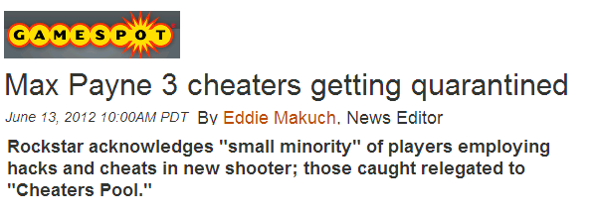
Motivation for Online Games
Online “games are a harbinger of software security issues to come” – Hoglund and McGraw
Cheaters reduce the quality of the game for honest players
Potentially impacting industry profits, $90 billion in 2015

Slide 8
Existing Solutions: Server-side Replica
CLIENT
SERVER
USER
INPUT
CLIENT
REPLICA
K. Vikram, A. Prateek, and B. Livshits.
Ripley: Automatically securing Web 2.0 applications through replicated execution.
In 16th ACM Conference on Computer and Communications Security, Nov. 2009.
Notes:
Require client to “show their work"
Forward initial process state, instruction trace, all external inputs (files, random numbers, time, keypresses)
Server “replays” client — check that output matches!
Ripley. etc
Way, way too expensive
client-side: bandwidth, tracing overhead
server-side: computational cost on server
Could we do this without forwarding any extra information?
(sort of, yes, with caveats, but pretty much!)

Slide 9
Existing Solutions: Abstract Model of Client Behavior
CLIENT
SERVER
CONTROL FLOW MODEL OF CLIENT
J. Giffin, S. Jha, and B. P. Miller.
Detecting manipulated remote call streams.
In 11th USENIX Security Symposium, Aug. 2002.
Guha, S. Krishnamurthi, and T. Jim.
Using static analysis for Ajax intrusion detection.
In 18th International World Wide Web Conference, Apr. 2009.
Notes:
Mimicry attacks

Slide 10
Our Goals
Detect if client messages are consistent with the sanctioned client software
Ideal criteria:
Precision
Client message sequences declared valid are actually legitimate
Minimize extra bandwidth
Low to zero data added to client messages
Speed
Detection -> Prevention
Client and server agnostic
Minimize developer effort
Notes:
Find a middle ground between a full server side replica and a potential imprecise client model

Slide 11
Thesis Statement
“Network messages from a remote client can be confirmed as consistent with the sanctioned client software, in some cases at a rate that keeps pace with the client application, without requiring significant modification to the client software.”
Notes:
Paraphrase at commas

Slide 12
Contributions
Novel verification framework for detection of client misbehavior
Demonstrate two verification strategies
Exhaustive
Optimistic
Demonstrate two techniques improve verification performance
Edit-distance based guidance
Parallel verification
Evaluation in the context of online games
XPilot
Tetrinet

Slide 13
Outline
Introduction
Symbolic Execution
Verification Strategies
Verification Optimizations
Case Study Evaluation
Conclusion

Slide 14
Symbolic Execution [King, 1976]
void foo(int x, int z) {
if (z > 0) {
int y = x/2;
if (y == 26) {
error();
}
}
}
z <= 0
z > 0
y = x/2
y != 26
y = x/2
y == 26
Assume symbolic inputs instead of concrete inputs
Constraints on input are constructed based on each execution path
Built upon KLEE [Cadar et al. 2008]
Feasible now, in part, due to advances in SMT solvers
Notes:
Reason path by path instead of input by input
Expressions in terms of symbolic input symbols and constraints in terms of the branch conditions
Used to determine what inputs will cause a program to execute
Used to derive the effects of a given program on a given system
Constraints on input are constructed based on each execution path
Used in the context of other security applications
Automated test generation [Cadar et al. 2006]
Deriving vulnerability signatures [Brumley et al. 2006]
Anonymizing private data [Wang et al. 2009]
C. Cadar, D. Dunbar, and D. Engler.
KLEE: Unassisted and automatic generation of high-coverage tests for complex systems programs.
In 8th USENIX Symposium on Operating Systems Design and Implementation, Dec. 2008.

Slide 15
Approach
Assumptions
Single-threaded client
Client executes a main event loop
Order of messages can be reconstructed server-side
Work at granularity of event loop iterations
Generate symbolic conditions server-side for each path
Serves as model of client behavior
Path conditions are “stitched” together to verify client messages
User Input
Read From Server
Update State
Send to Server
Render
Client Event Loop
Notes:
=================================================
Let’s now look at our approach in more detail.
First we require the game client to operate in a single-threaded looping fashion,
executing a repeated series of events.
(#)Next, to make symbolic execution feasible,
we generate constraints at the granularity of loop iterations
(#)Called Round Constraints and
These round constraints are what serve as the model of how the client operates.
Finally, we use the round constraints to
check the results of a single loop execution of the client.
And the round constraints are stitched together over time in order
to verify the consistency of a sequence of client messages.

Slide 16
Symbolic Environment
How can we use symbolic execution on the server to verify a message from a client?
1
2
3
4
5
6
7
8
9
10
11
12
loc = 0
while true do
key = readKey()
if key == ESC then
sendQuitMsg()
else if key == UP then
loc = loc + 1
else if key == DN then
loc = loc – 1
end if
sendMsg(loc)
end while
key = symbolicReadKey()
msg = “quit”
msg = loc

Slide 17
Symbolic Environment
Symbolic State
Execution Prefix
loc == 0 ∧
key == ESC ∧
msg == “quit”
1,2,3,4,5
1
2
3
4
5
6
7
8
9
10
11
12
loc = 0
while true do
key = symbolicReadKey()
if key == ESC then
msg = “quit”
else if key == UP then
loc = loc + 1
else if key == DN then
loc = loc – 1
end if
msg = loc
end while

Slide 18
Symbolic Environment
Symbolic State
Execution Prefix
loc == 0 ∧
key == ESC ∧
msg == “quit”
1,2,3,4,5
1
2
3
4
5
6
7
8
9
10
11
12
loc = 0
while true do
key = symbolicReadKey()
if key == ESC then
msg = “quit”
else if key == UP then
loc = loc + 1
else if key == DN then
loc = loc – 1
end if
msg = loc
end while
loc == 1
∧ key == UP
∧ msg == loc
1,2,3,4,6, 7,11

Slide 19
Symbolic Environment
Symbolic State
Execution Prefix
loc == 0 ∧
key == ESC ∧
msg == “quit”
1,2,3,4,5
1
2
3
4
5
6
7
8
9
10
11
12
loc = 0
while true do
key = symbolicReadKey()
if key == ESC then
msg = “quit”
else if key == UP then
loc = loc + 1
else if key == DN then
loc = loc – 1
end if
msg = loc
end while
loc == 1
∧ key == UP
∧ msg == loc
1,2,3,4,6, 7,11
loc == -1
∧ key == DN
∧ msg == loc
1,2,3,4,6, 8,9,11

Slide 20


Checking a Client Message
Symbolic State
Execution Prefix
Client Message: msg₀
loc == 0 ∧
key == ESC ∧
msg == “quit”
msg == 1
1,2,3,4,5
<location>1</location>
Check consistency of message with formulas generated via symbolic execution.
loc == 1
∧ key == UP
msg == loc
∧ msg == 1
1,2,3,4,6, 7,11
loc == -1
∧ key == DN
∧ msg == loc
∧ msg == 1
1,2,3,4,6, 8,9,11
Satisfiability Modulo Theory (SMT) Solver
[STP, Ganesh et al. 2007]

Slide 21
Outline
Introduction
Symbolic Execution
Verification Strategies
Exhaustive
Optimistic
Verification Optimizations
Case Study Evaluation
Conclusion

Slide 22


Exhaustive Verification [Bethea, Cochran and Reiter, 2011]
Init.
msg₀
msg₁
msg₂
Explore all paths
Optimizations
Aggressively prune paths
Merge equivalent states
Assumptions
Bounded client event loop
loc₀
loc₁
loc₂
loc₃
Notes:
=================================================
OK, so we’ve now seen
how a single client iteration is verified using the round constraints.
In this diagram, we’ll see an example of how we
accumulate round constraint over time, in a constraint tree.
Each vertical line, represents when the server receives a message from the client.
(#) The root of the tree is the initial state of the client, loc_0.
Each path from the root to a leaf node represents a
series of execution paths the client could have taken.
As we receive messages from the client,
we get a more complete picture of what is going on
and are able to remove paths as they become un-satisifiable.
This should give you a high level view of how the verifier can track the
possible states the client could currently be in.
So there are possibly a large number of paths created for a given message log.
But the client messages reduce ambiguity.
We also perform various optimizations…

Slide 23
Optimistic Verification [Cochran and Reiter, 2013]
Init.
msg₀
msg₁
msg₂
Find just one path
Greedy approach
May need to backtrack
Don’t need to bound number of paths in client event loop
loc₀
loc₁
loc₂
loc₃

Slide 24
Verification Strategy Overview
Legitimate
Not Legitimate
Verification Time
Exhaustive Verifier
Optimistic Verifier
Exhaustive Verification
No difference between legitimate clients (common) and non-legitimate (uncommon)
Optimistic Verification
Prioritize common case (legitimate clients)
Notes:
Exhaustive will examine all paths in turn
Given that our problem is undecidable in the general case, optimistic is the more practical approach
Verifier takes a message sequence, a time budget and outputs Valid, Invalid or Not sure
Optimistic is “greedy” so there is a notion of which paths to prioritize

Slide 25
Outline
Introduction
Symbolic Execution
Verification Strategies
Verifier Optimizations
Edit Distance Path Guidance
Parallel Verification
Case Study Evaluation
Conclusion

Slide 26
Optimistic Verification Details
Execution Prefix: 𝚷
Sequence of client instructions
msg₀
msg₁
msg₂
Execution fragment 𝜋
Instruction sequences executed between between network events
Execution prefix 𝚷_{n}
“Chain” of execution fragments consistent with msg₀, msg₁, … msg_{n}
π₂
π₃
π₁
Notes:
Lets show some detail on verification between messages
Let’s look at how we extend an execution prefix

Slide 27
Verification: Extending 𝚷_{n-1}
Each node holds:
Symbolic state σ
Memory, Stack, Registers
Path constraints
Execution fragment 𝜋
Instruction sequence from previous network I/O node
New edges formed when a symbolic branch is reached
Net I/O
Invalid
Live
Dead
0
1
0
1
1
0
Notes:
Exploration between network events can be represented by a binary tree
Algorithm symbolically executes each leaf node until it finds an execution fragment that is consistent with msg_{n}

Slide 28
Guided Path Selection
How to prioritize path selection?
Idea: use the next network message!
Build training corpus of execution fragments
Select next node to explore using training data
0
1
0
1
0
1
0
Notes:
DFS may get stuck in loop
BFS is too slow
Key Insight:
Correlate message contents with previously executed paths
Settled on prefix-edit distance with a bound on max distance

Slide 29
Guided Path Selection
Objective
Find path consistent with msg_{n}
Input
Message to verify: msg_{n}
Training Corpus
Execution fragments
Messages sent at the end of each
Output
Subset of training execution fragments

Slide 30
Building Training Corpus
Trace₁
Trace₂
Trace₃
Execute client software to generate a set of message traces.
msg_{1,0}
msg_{2,0}
msg_{3,0}
π_{1,1}
π_{2,1}
π_{3,1}
msg_{1,1}
msg_{2,1}
msg_{3,1}
π_{1,2}
Split each trace into a set of execution fragments π_{i,j}
π_{2,2}
π_{3,2}
msg_{1,2}
msg_{2,2}
msg_{3,2}
π_{1,3}
π_{2,3}
π_{3,3}
msg_{1,3}
msg_{2,3}
msg_{3,3}
Associate each π_{i,j} with the set of messages it is consistent with.
π_{1,4}
π_{2,4}
π_{3,4}
msg_{1,4}
msg_{2,4}
msg_{3,4}
EXAMPLE:
π_{1,1} | 1, 2, 3, 4, 6, 7, 11
π_{2,3} | 1, 2, 3, 4, 6, 7, 11
π_{3,2} | 1, 2, 3, 4, 6, 8, 9, 11
msg_{1,1} | <location>1</location>

Slide 31
Clustering Training Data
Cluster execution fragments recorded in training
π_{1,1}
π_{6,1}
π_{2,1}
π_{2,4}
π_{4,1}
π_{2,3}
π_{3,2}
π_{5,1}
π_{1,2}
π_{3,2}
π_{3,1}
π_{1,2}
π_{5,2}
π_{4,2}
π_{3,3}
π_{2,2}
π_{5,3}
π_{6,2}
π_{3,3}
π_{1,3}
π_{5,3}
π_{3,4}
π_{6,4}
π_{6,3}
π_{1,4}
π_{5,4}
π_{4,3}
π_{1,4}
π_{5,4}
π_{4,4}
Cluster network messages recorded in training
msg_{3,4}
msg_{4,3}
msg_{1,1}
msg_{1,1}
msg_{3,1}
msg_{4,2}
msg_{6,0}
msg_{3,1}
msg_{3,2}
msg_{2,1}
msg_{2,3}
msg_{6,3}
msg_{1,0}
msg_{1,0}
msg_{1,2}
msg_{2,0}
msg_{3,0}
msg_{1,2}
msg_{2,2}
msg_{2,2}
msg_{2,4}
msg_{5,4}
msg_{5,0}
msg_{1,3}
msg_{1,3}
msg_{1,4}
msg_{3,3}
msg_{5,3}

Slide 32
Mapping Client Message to Training Data
msg_{n}
π_{4,2}
Map message medoids to execution fragment medoids
msg_{1,1}
π_{3,2}
msg_{3,1}
π_{1,2}
π_{3,3}
msg_{1,0}
Find message medoid “closest” to msg_{n} via edit distance
π_{5,3}
msg_{1,2}
π_{1,4}
msg_{2,2}
π_{5,4}
Use associated execution fragment medoids to guide search
π_{2,1}
Notes:
Select live node with path π′ “closest” to execution fragment in φ
in terms of edit distance.

Slide 33
Node Selection Via Training Data
Prioritize live node “closest” to training execution fragments
Distance metric optimizations
Radix tree of execution fragments
Used prefix edit distance
Intuition: “autocomplete”
Bound the max edit distance [Ukkonen, 85]
0
1
0
1
0
1
0
Notes:
Select live node with path ′ “closest” to execution fragment in 𝚽
in terms of edit distance.
O(|π_{j}|⋅|π′|) -> O(t⋅min(|π_{j}|,|π′|))

Slide 34
Outline
Introduction
Symbolic Execution
Verification Strategies
Verification Optimizations
Edit Distance Path Guidance
Parallel Verification
Case Study Evaluation
Conclusion

Slide 35
Parallel Verification
Verification technique is naturally parallelizable
Existing work: states executed from the beginning
[Cloud9, 2011]
Criteria
Global information
Shared constraint caches and state data
Require multi-threaded approach
Worker₃
Worker₄
Worker₁
Worker₂

Slide 36
SParKLEE: Multi-Threaded KLEE
Concurrent exploration of states
Minimal lock contention
Support concurrent queries to the constraint solver
Verification use-case was design priority…
… but baseline symbolic execution still benefits
Notes:
SParKLEE?

Slide 37
Parallel Verification Architecture
Scheduler
msg_{n}
Training Clusterer
Node Types
{ , ,…}
{π_{5,4} , π_{2,1} }
Root
Worker₃
Worker₄
Dead
Worker₁
Worker₂
Infant
Ready Queue
Added Queue
Live
Active
Key design goal: minimize contention
1 Scheduler thread
1 Training Clusterer thread
N Worker Threads
Worker₁
Worker₂
Worker₃
Worker₄
Notes:
Scheduler thread prioritizes execution paths
BFS until Training Clusterer thread returns results
Worker threads execute up to the next symbolic branch, then push child states onto lock-free queues

Slide 38
Further Performance Improvements
Macro: path explosion problem
Micro: small optimizations can have big impact
Applying symbolic execution: verification vs bug-finding
Repeated execution of same code paths
Use canonicalization to better exercise caches
Merge “duplicate” states
Memory pressure
Aggressively prune states and constraints

Slide 39
Outline
Introduction
Symbolic Execution
Verification Strategies
Verification Optimizations
Case Studies
Conclusion

Slide 40
Verifier Implementation: Cliver
“Client-Verification”
Built upon KLEE
[Cadar et al. 2008]
Implements optimistic verification
Clients under test compiled into LLVM bitcode
Cliver
Training Data
Execution
Paths
Client
Bitcode
KLEE Symbolic Virtual Machine
…
Execution
States
Message Trace
Network
Model
OS / Env.
Model
Library
Bitcode

Slide 41
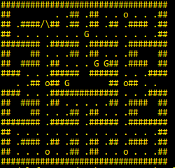
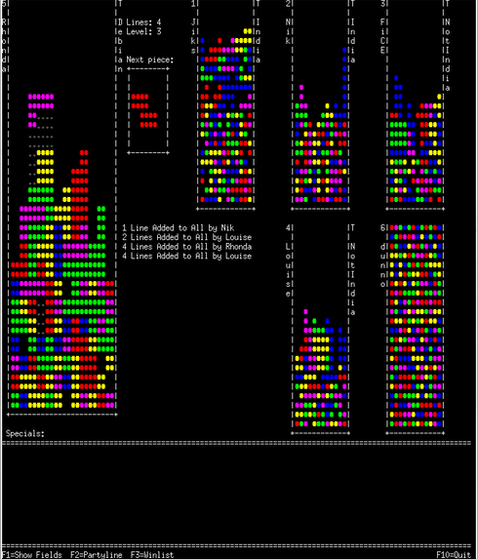
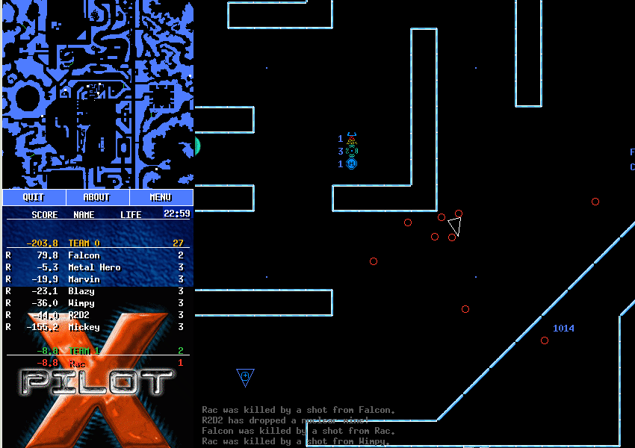
Case Studies
Capman
Multiplayer Tetris game
~5000 lines of C on client
XPilot
Open-source multiplayer 2D shooter
~50000 lines of C on client
Clone of PacMan, with bombs!
1000 lines of C on client
Bomb placement must correlate to previous position
Tetrinet
Player can create false line cleared message
Little client side state but player can enable shields, while shooting

Slide 42
Measuring Performance
CLIENT
SERVER
MESSAGE QUEUE
Verification Cost
3
2
1
VERIFIER
Verification Delay
Time
Notes:
Only for legitimate clients

Slide 43
Case Studies: Configurations
Experiment setup
User generated
k-fold cross validation
Configurations
Guided Single-thread
Guided Parallel

Slide 44
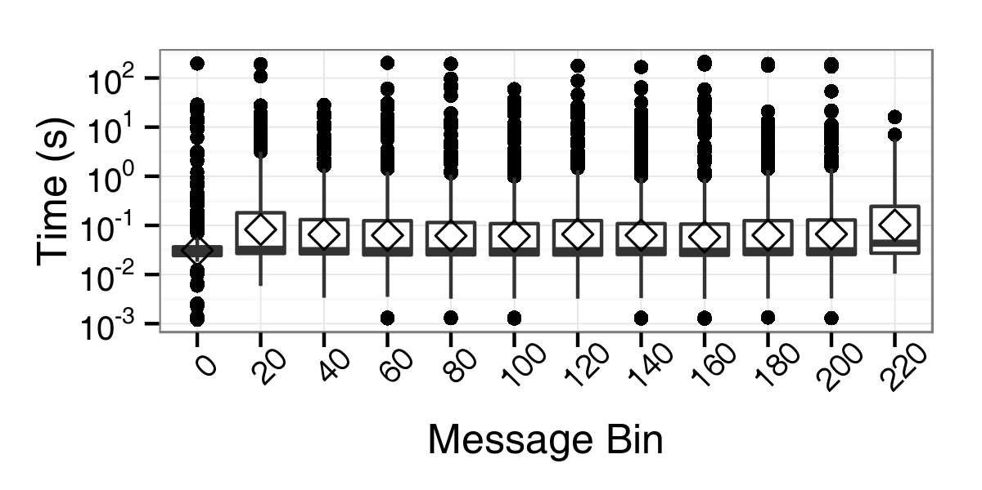
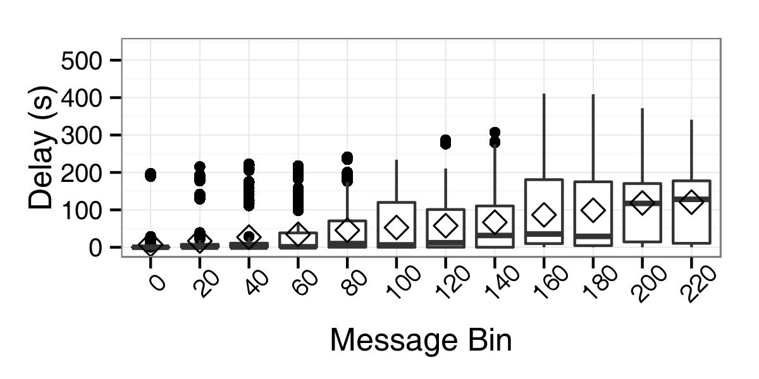
TetriNET: Single-thread
20 Experiments
400 points per bin
Game time: ~6.5 minutes
Average verification cost is less than intermessage time of 1.6 seconds
Worst case cost > 100 sec
Delay increases over time
Cost (s)

Slide 45
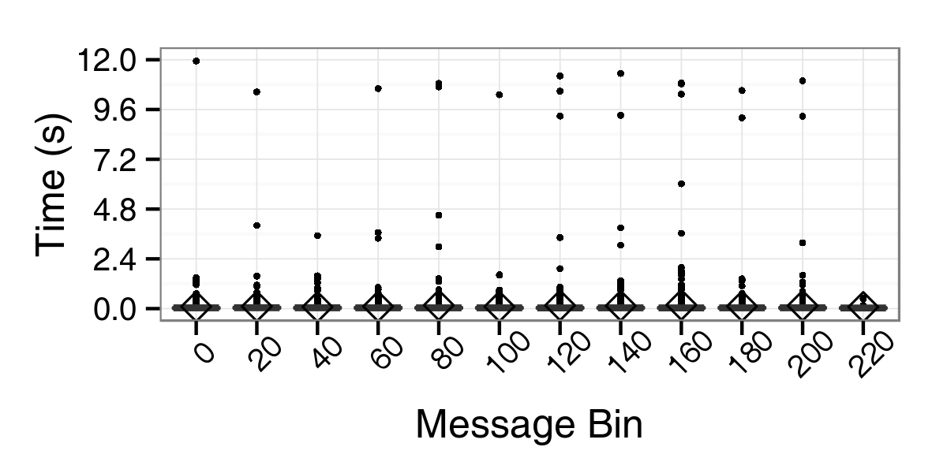
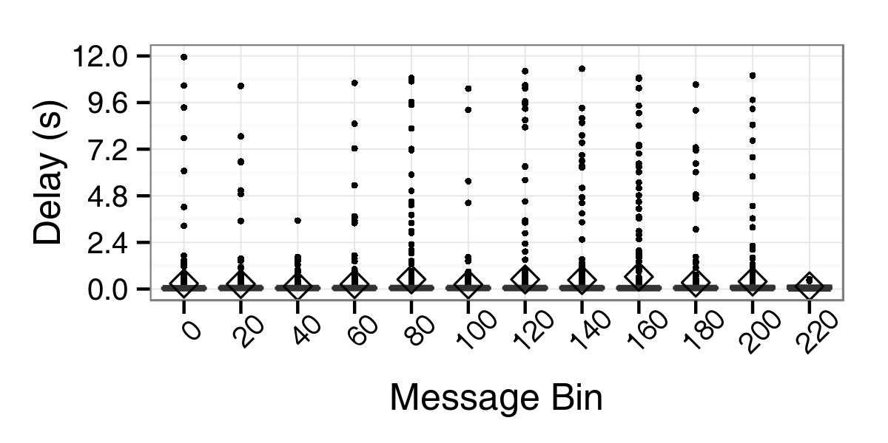
Tetrinet: Parallel
16 worker threads
Verification cost
Max cost: >100 secs. to 12 secs.
10X improvement
Verification delay
Max delay : >400 secs. to 13 secs.
Over 25X improvement over single-threaded worst case!
Cost (s)

Slide 46
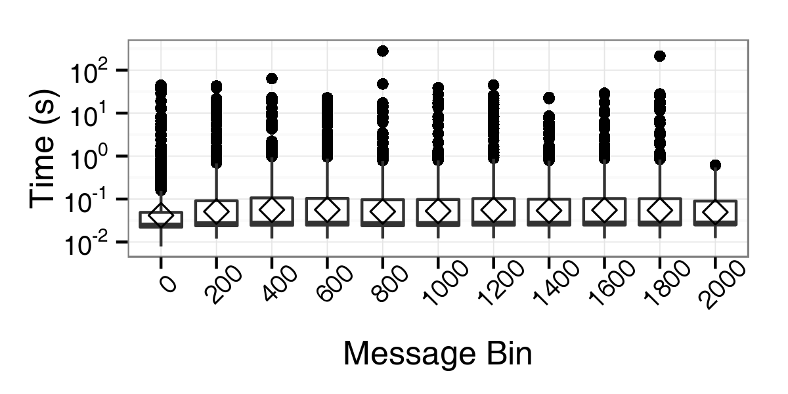
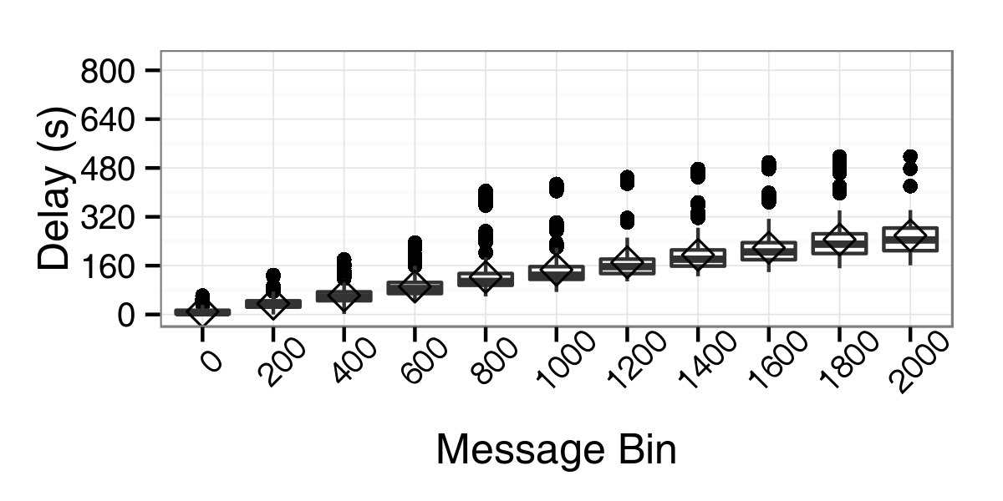
Xpilot: Single-Thread
40-fold cross validation
4000 points per bin
Rate: 32 messages/second
Verification cost doesn’t increase over time
Per message verification mean < 100ms
Delay increases over time
Cost (s)

Slide 47
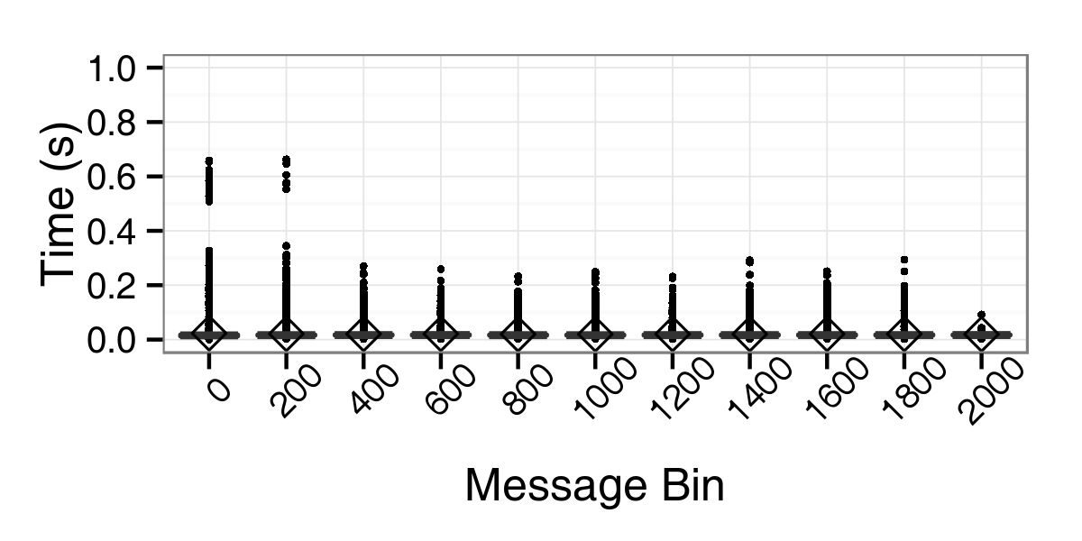
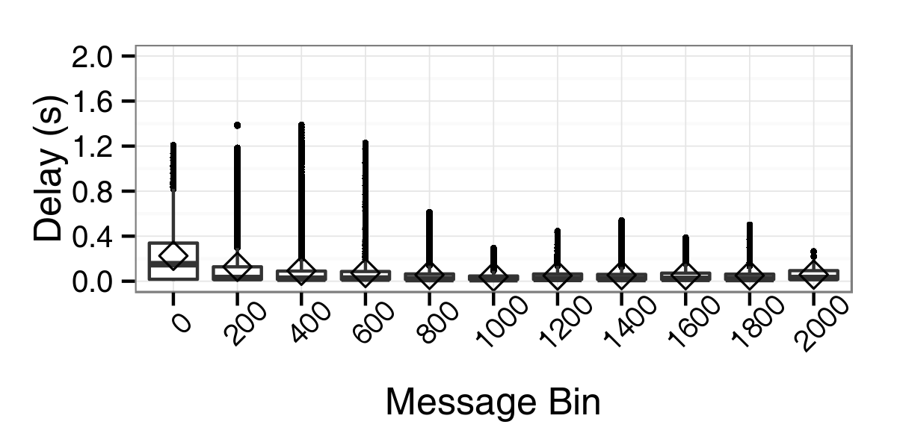
XPilot: Parallel
16 worker threads
Verification cost
Max: 70 ms
Verification delay
Mean: 70 ms
Max: 1.2 seconds
Verifer can keep pace with client!
Cost (s)

Slide 48
Conclusion
Novel verification framework for detection of client misbehavior
Demonstrated two verification strategies
Demonstrated optimizations that push verification performance
Evaluation in the context of online games
With optimizations, keep pace with case study applications

Slide 49

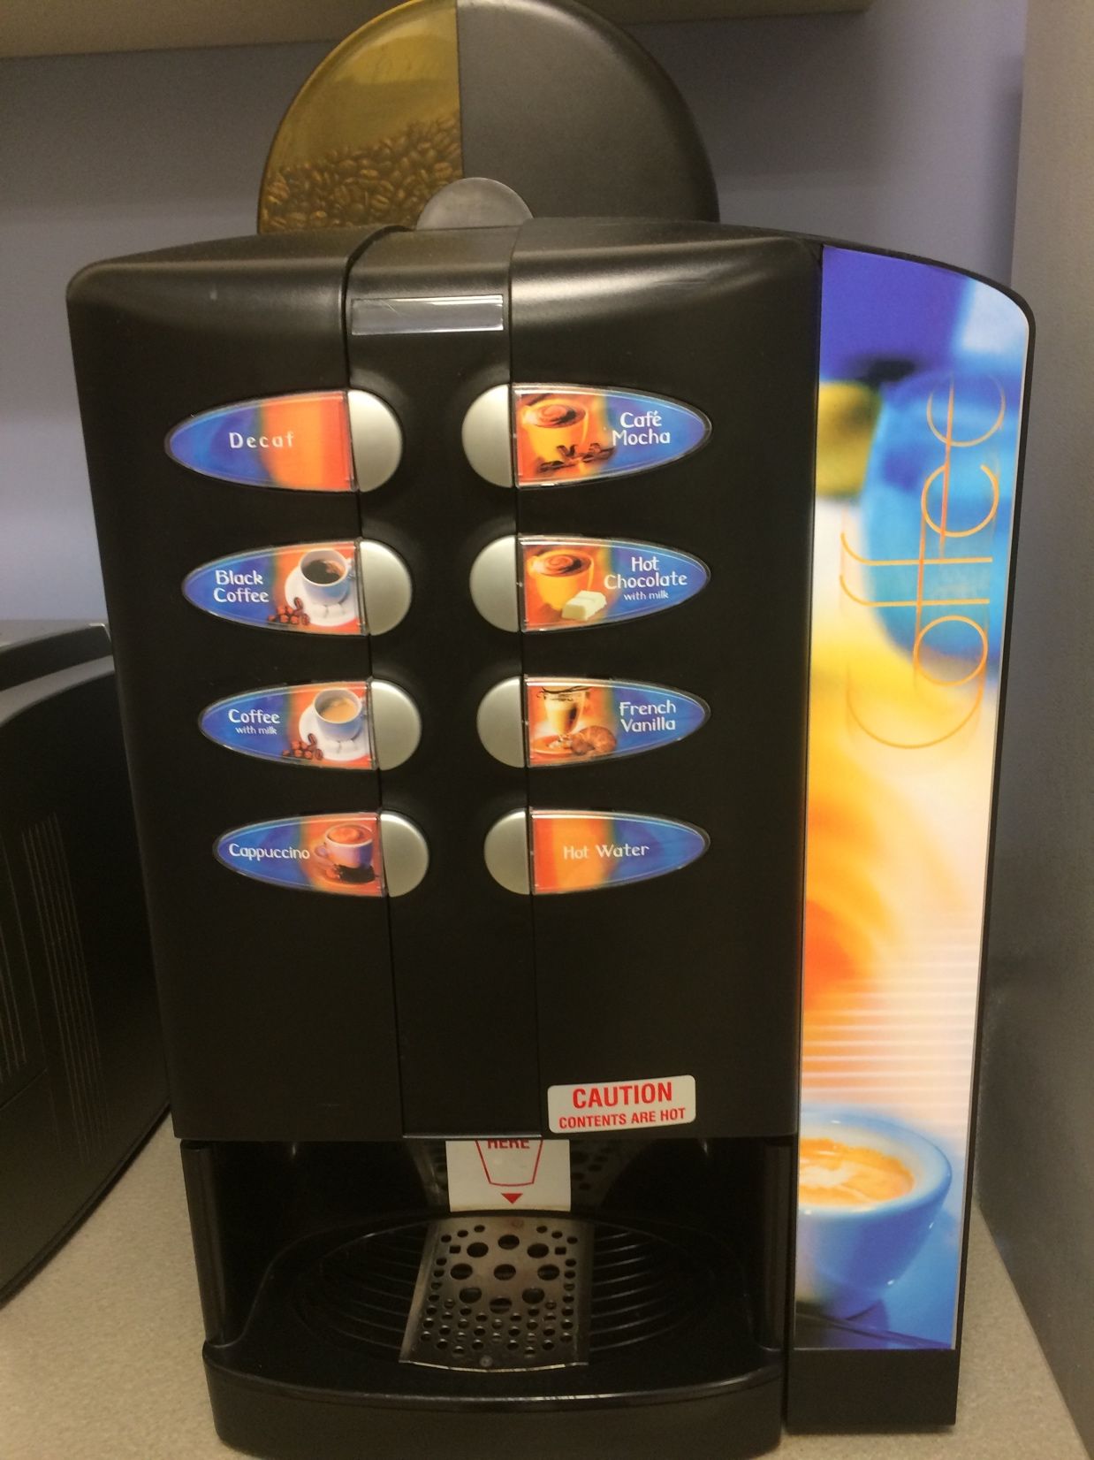
Thank You!
My advisor Mike Reiter
Committee
CS Department faculty and staff
Fellow security group students
Collaborators
Darrell Bethea, Andrew Chi, Marie Nesfield and Cynthia Sturton
3rd Floor coffee machines

Slide 50
Questions?

Slide 51
Future Work
Automatically remove irrelevant client instructions
Program slicing
Improved metrics for training data
Reduce overhead of executing instructions
Function summaries, bridge exhaustive and optimistic
Switch interpreter to native [S2E]
Notes:
Keep it punchy

Slide 52
Additional Optimizations
Edit distance calculations
Avoid repeated work at all levels
State equivalence testing
Pointer tracking used to walk address space
Canonicalization of constraints
Better utilization of caches
Memory management
Live destruction/reconstruction of state data

Slide 53
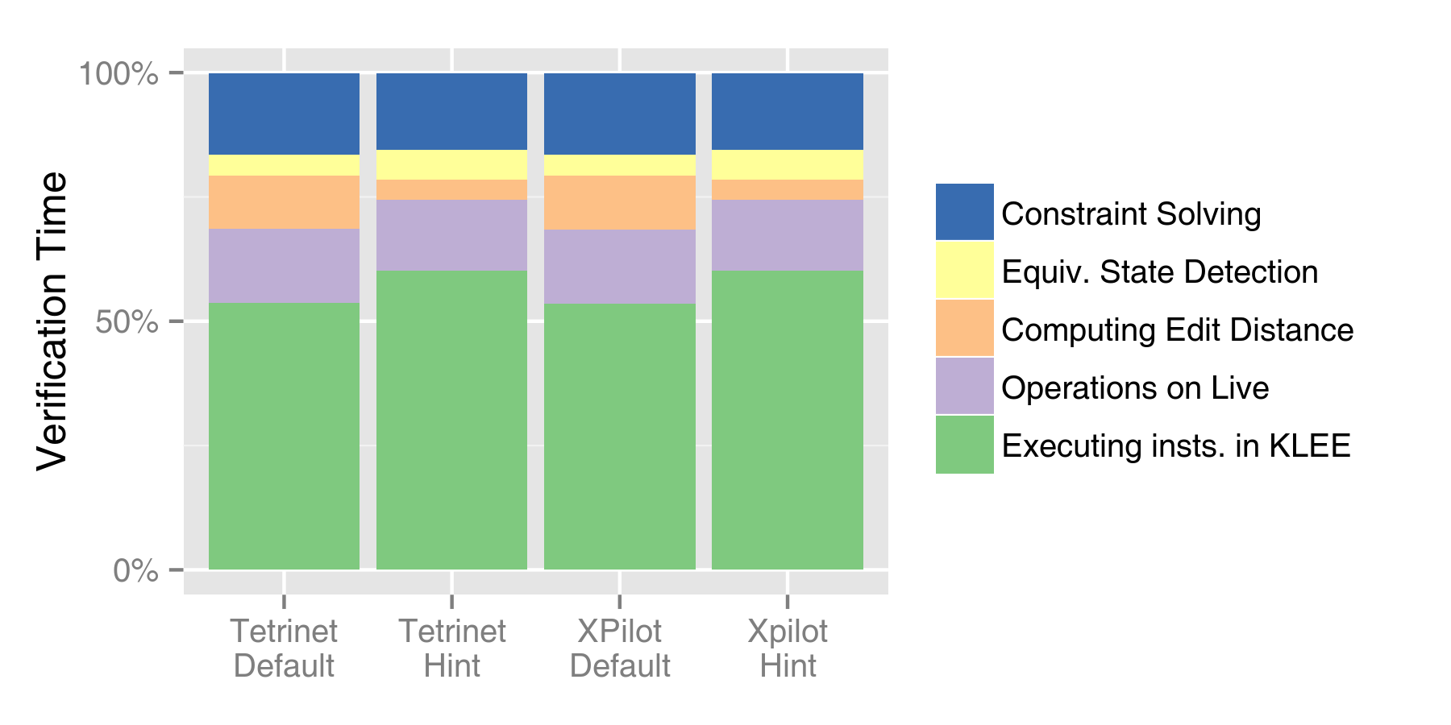
Interpreter Overhead

Slide 54
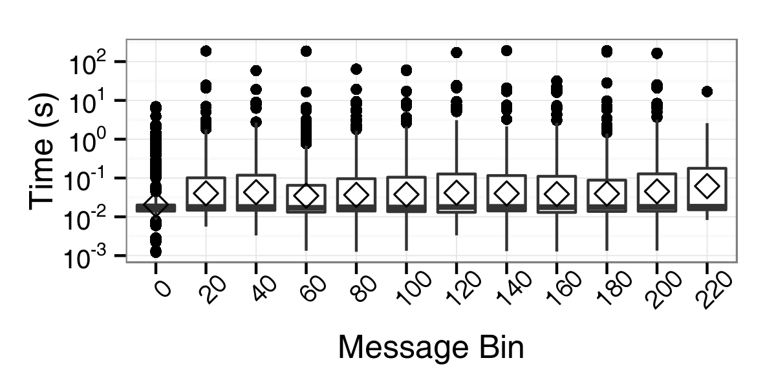
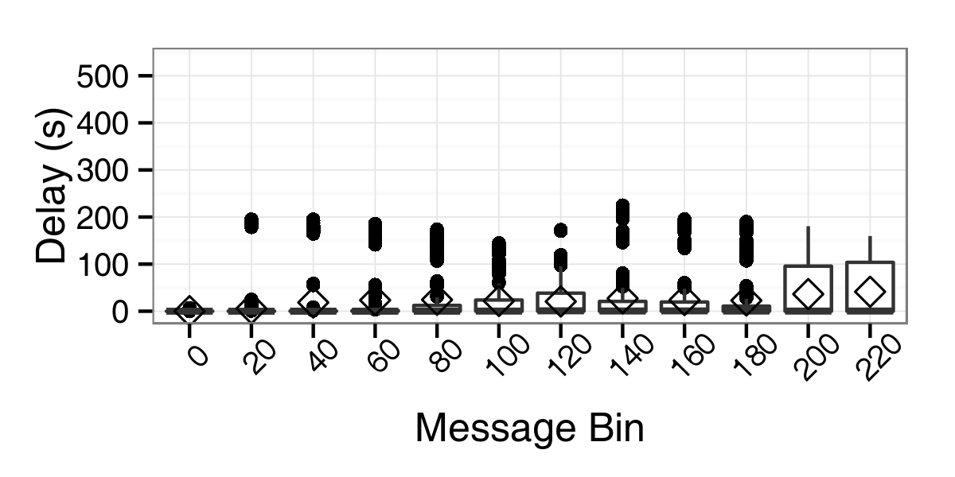
TetriNET: Hint Configuration
20-fold cross validation
Average game 6.5 minutes
20x20 = 400 points per bin
Better performance with hint, fewer outlier points
Hint configuration keeps up with gameplay in the common case
Median delay is near zero

Slide 55
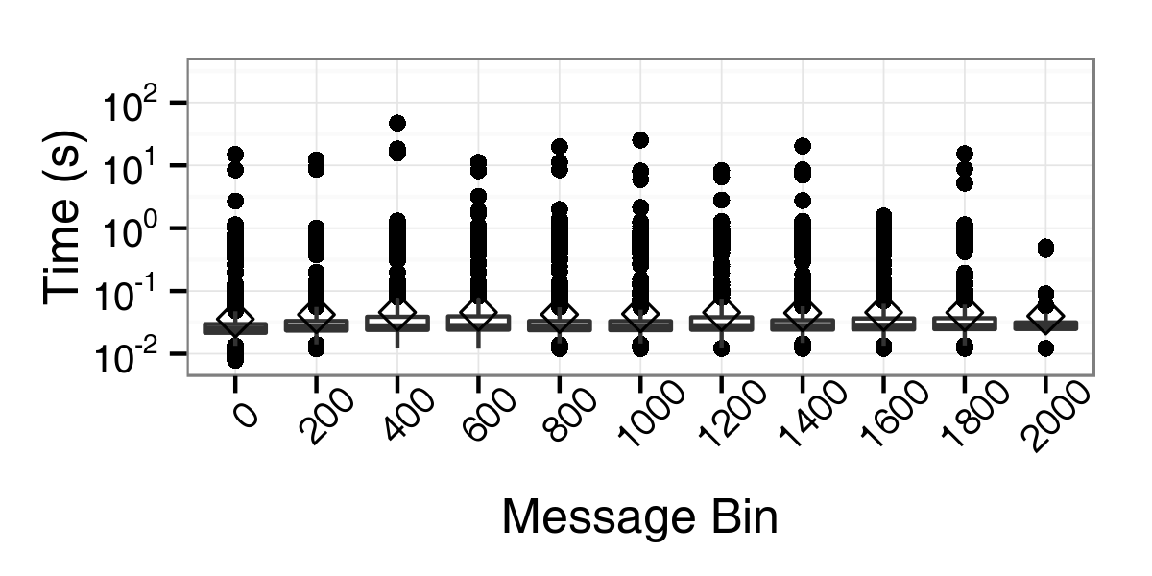
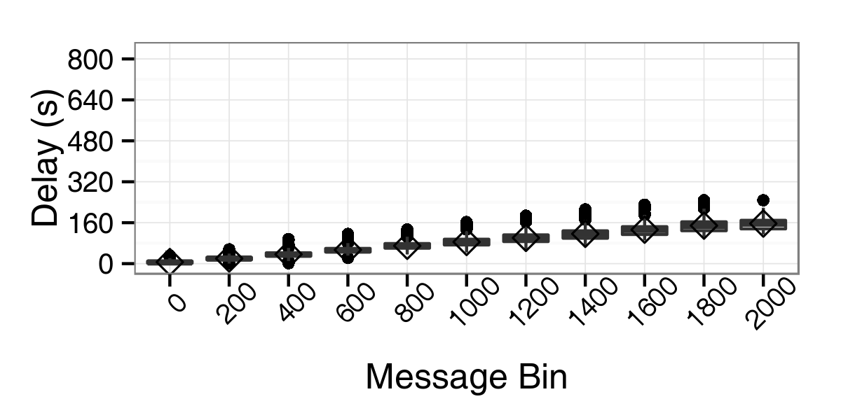
XPilot: Hint Configuration
40-fold cross validation
4000 points per bin
Average: 32 messages/second
Hint configuration does a better job of keeping up with gameplay

Slide 56
Publications
Server-side verification of client behavior in online games. D. Bethea, R. Cochran and M. K. Reiter. In Proceedings of the 17th Network and Distributed System Security Symposium (NDSS '10), February 2010. Best Paper Award
Server-side verification of client behavior in online games. D. Bethea, R. Cochran and M. K. Reiter. In ACM Transactions on Information and System Security, 14(4), December 2011.
Toward Online Verification of Client Behavior in Distributed Applications R. Cochran and M. K. Reiter. In Proceedings of the 20th Network and Distributed System Security Symposium (NDSS '13), San Diego, CA, February 2013.

Slide 57


Exhaustive (Eager)
Clients
During session
Message Sequence Logs
Message Logs
Message Logs
Server
Offline
Client Source Code
Eager
Model Generator
Verifier
OR
Constraints
✓
X
Once
Every message
Notes:
Let’s look at a more detailed version of the arch
Using each of these strategies, first, eager.
57

Slide 58
Exhaustive (Lazy)
Clients
During session
Message Sequence Logs
Message Logs
Message Logs
Server
Offline
Client Source Code
Verifier
OR
✓
X
Every message
Notes:
58

Slide 59
Optimistic
Clients
During sessions
Messages
Message Logs
Message Logs
Server
ASAP
OR
OR
Client Source Code
Optimistic
Verifier
✓
X
?
Notes:
59

Slide 60
Optimistic Verification
ALGORITHM OBJECTIVE:
Find path 𝜋_{n} from to consistent with msg_{n}
Net I/O Node
Invalid Node
Live Node
Explored Node
0
1
ALGORITHM INPUT:
Execution Prefix: Π_{n-1}
Net I/O Node with σ_{n-1}
Next Message: msg_{n}
0
1
1
0
Notes:
Fix pi_n-1

Slide 61
Verifier Placement
Off-line Verification:
msg
msg
msg
OR
✓
CLIENT
SERVER
VERIFIER
X
msg
msg
msg
On-line Verification:
msg
msg
OR
msg
✓
CLIENT
VERIFIER
X
SERVER
msg
msg
msg

Slide 62
Verifier Architecture
Verifier
Training Data
Execution
Paths
OR
✓
Client
Bitcode
Symbolic Virtual Machine
X
…
Execution
States
Message Trace
Network
Model
OS / Env.
Model
Library
Bitcode

Slide 63
Verifier (v. 1)
CLIENT
SERVER
OFFLINE
MESSAGE LOG
VERIFIER
D. Bethea, R. Cochran and M. K. Reiter.
Server-side verification of client behavior in online games.
In ACM Transactions on Information and System Security, 14(4). 2011.

Slide 64
Verifier (v. 2)
CLIENT
SERVER
ONLINE
MESSAGE QUEUE
VERIFIER
R. Cochran and M. K. Reiter.
Toward Online Verification of Client Behavior in Distributed Applications
In 20th Annual Network and Distributed System Security Symposium, Feb. 2013.

Slide 65
Verifier (v. 3)
CLIENT
VERIFIER
SERVER

Slide 66
Verification Algorithm
{ ,…}
Initialize: ←
While > 0
← selectNode( ) with state σ and path π
If σ.nextInst is not symbolic branch
σ ← execStep(σ)
π ← π || σ.nextInst
If ¬((σ.constraints ∧ msg_{n} ) ⇒ false)
← ∪
Else
Create nodes (σ₀, π₀) and (σ₁, π₁)
← ∪ ∪
If ∈
return π
return ⊥
Net I/O Node
Invalid Node
Live Node (σ,π)
|{ ,…}|
{ ,…}
{ , ,…}
{ , ,…}
{ }
0
1
0
1
0
1
0
1
{ , ,…}
{ , ,…}
{ 0 }
{ 1 }
{ }
0
1

